Slide 1

VIDYA JYOTHI INSTITUTE OF TECHNOLOGY (Autonomous)
TRAFFIC MANAGEMENT FOR EMERGENCY
VEHICLE PRIORITY BASED ON VISUAL SENSING.
Under the Guidance of:
Ms. D.Anusha
Assistant Professor AI-DS Dept.
By :
R.ANKITHA-22911A7250
Department of Artificial Intelligence & Data Science
Notes:
1

Slide 2
ABSTRACT
Vehicular traffic is continually increasing everywhere in the world and can cause terrible traffic congestion at intersections. Most of the traffic lights today feature a fixed green light sequence, therefore the green light sequence is determined without taking the presence of the emergency vehicles into account. Thus, loss of property and valuable human life is guaranteed if an emergency vehicle such as an ambulance, police car, fire engine, and the like becomes stuck in a traffic queue and becomes late to the destination. This work gives an approach to scheduling emergency vehicles in traffic.
The approach combines the measurement of the distance between the emergency vehicle and an intersection using visual sensing methods, vehicle counting and time sensitive alert transmission within the sensor network. The distance between the emergency vehicle and the intersection is calculated for comparison using Euclidean distance, Manhattan distance and Canberra distance techniques. The experimental results have demonstrated that Euclidean distance is superior to other distance measurement techniques. Visual sensing detects emergency vehicles in real-time with deep learning models, thus improving the accuracy and speed of response. Deep learning algorithms prioritize emergency vehicles by dynamically adjusting traffic lights for a faster route. Visual systems analyze traffic patterns to create unobstructed paths for emergency vehicles, thus minimizing delays.
Department of Artificial Intelligence & Data Science

Slide 3
INTRODUCTION
Traffic management is a critical aspect of urban infrastructure, ensuring the smooth flow of vehicles while minimizing delays and risks to public safety. Emergency vehicles, such as ambulances, fire trucks, and police cars, are particularly sensitive to delays as they need to reach their destinations as quickly as possible during critical situations. In traditional traffic systems, emergency vehicles often face obstacles such as congestion, traffic signals, and non-compliant drivers, which can hinder their response time.
Emerging Technologies for Emergency Vehicle Priority.
To address this challenge, modern traffic management systems are increasingly incorporating advanced technologies such as visual sensing, which enables a more adaptive and intelligent approach to traffic control. Visual sensing typically refers to systems that use cameras, computer vision algorithms, and other imaging technologies to monitor and analyze traffic conditions in real-time. By employing these technologies, traffic management systems can enhance their ability to identify emergency vehicles and provide them with priority passage through traffic.
Department of Artificial Intelligence & Data Science

Slide 4
Literature Survey - Base paper
Paper 1: Traffic Management For Emergency Vehicle Priority Based on Visual Sensing
Authors: Gerhard P.Hancke,Kapileshwar Nellore.
Published by & Year: MDPI & 2016.
About paper:
This paper presented an approach to schedule emergency vehicles in traffic. The approach combines the measurement of distance between the emergency vehicle and intersection using visual sensing methods, vehicle counting and time sensitive alert transmission within the sensor network. The distance between the emergency vehicle and the intersection is calculated from visual data using Euclidean distance, Manhattan distance and Canberra distance techniques for comparison. The experimental results have shown that the Euclidean distance outperforms other distance measurement techniques and is suitable for real-time applications. The measured information like vehicle count, distance and speed are very useful for a traffic management center to manage emergency traffic efficiently.
Department of Artificial Intelligence & Data Science

Slide 5
EXISTING METHOD
FIXED TRAFFIC CONTROL: The traffic signal system uses a fixed timing sequence that does not adapt to real-time conditions, causing delays for emergency vehicle.
Lack of Real-Time Analysis : The system does not incorporate real-time data processing, making it inefficient in detecting and prioritizing emergency vehicles.
No Automated Detection : Emergency vehicle detection is manual or relies on basic methods, such as GPS or strobe lights, leading to slower response times.
Department of Artificial Intelligence & Data Science

Slide 6
PROPOSED SYSTEMS
The deployed traffic management system based on deep learning could be an innovative system for emergency vehicle prioritization and general traffic flow. This will enable real-time detection and traffic signals that can be altered dynamically. All of this will work toward improving emergency response operations and assuring the safety of other traffic users.
🎥 Real-Time Emergency Vehicle Detection :
Deep leaning (CNNs) processes video feeds to instantly detect emergency vehicles and clear the path.
Adaptive Traffic Signal Control : Deep learning adjusts traffic signal timings based on the speed and proximity of emergency vehicles.
Predictive Traffic Flow Analysis : Models predict congestion and optimize traffic signal timings to reduce bottlenecks.
Optimizing Data Transmission Through PE-MAC : Deep learning optimizes the PE-MAC protocol, improving communication between vehicles and the Traffic Management Centre.
Improved Road Safety : The system reduces accident risks by prioritizing emergency vehicles and optimizing traffic flow.
Department of Artificial Intelligence & Data Science

Slide 7
PROPOSED MODEL METHODOLOGY
Data Collection : Gather real-time video data from traffic cameras and existing datasets, focusing on emergency vehicles.
Preprocessing : Extract frames from video , apply image processing ( noise reduction, background and subtraction),and define regions of interest(roads).
Vehicle Detection :Use object dectection models (e.g : YOLO, Faster R-CNN) to identify vehicles.
Emergency Vehicle Identification : Apply deep learning models (CNN) to classify emergency vehicles.
Department of Artificial Intelligence & Data Science

Slide 8
SYSTEM REQUIREMENTS
Hardware Requirements
Processor: Multi-core processor, preferably Intel i7/i9
RAM: Minimum 16 GB (32 GB recommended for smooth multitasking)
Hard Disk:256 GB minimum (SSD preferred for faster boot and data access)
Camera: Built-in or external webcam (720p or higher)
Microphone: Required for voice assistant features
Software Requirements
Operating System: Windows 10 or higher (64-bit)
Programming Language: Python 3.xN(most deep learning libraries are well supported in Python),HTML, CSS, BootStrap, and JavaScript
IDE : Pycharm, Visual Studio
Department of Artificial Intelligence & Data Science

Slide 9
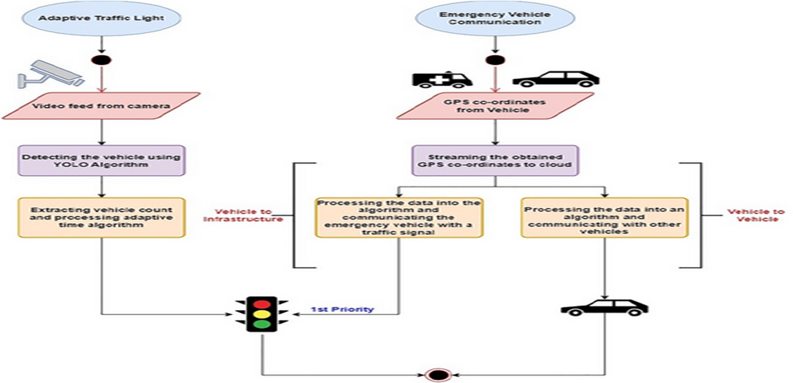
SYSTEM ARCHITECTURE
Department of Artificial Intelligence & Data Science

Slide 10
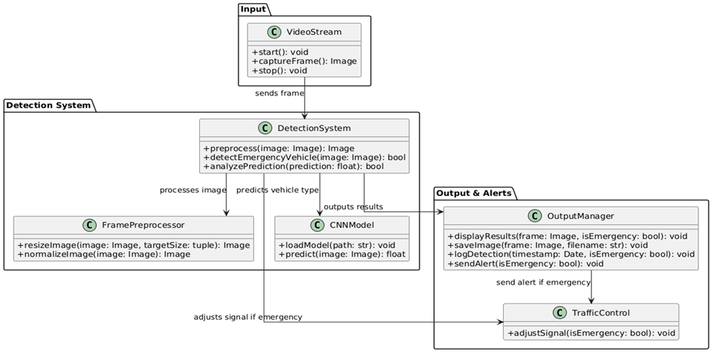
UML DIAGRAMS
UML stands for Unified Modeling Language. UML is a standardized general-purpose modeling language in the field of object-oriented software engineering.
Class Diagram
Collabration Diagram
Department of Artificial Intelligence & Data Science

Slide 11
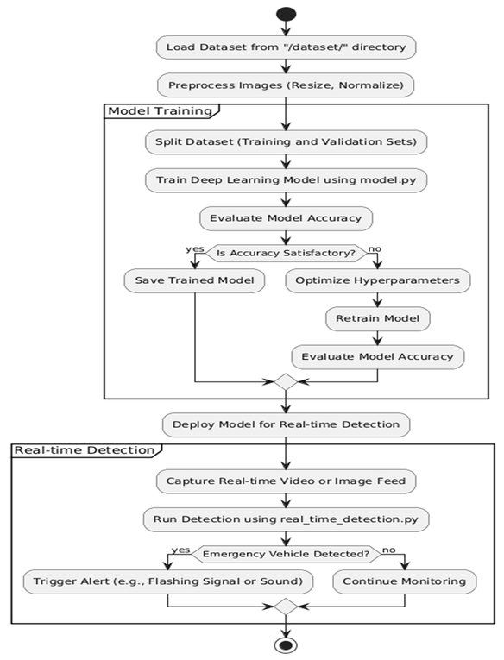
UML DIAGRAMS
This activity diagram illustrates the structured workflow for detecting emergency vehicles and optimizing traffic management based on real-time video feeds. The process can be broken down into the following stages
Activity diagram
Department of Artificial Intelligence & Data Science

Slide 12
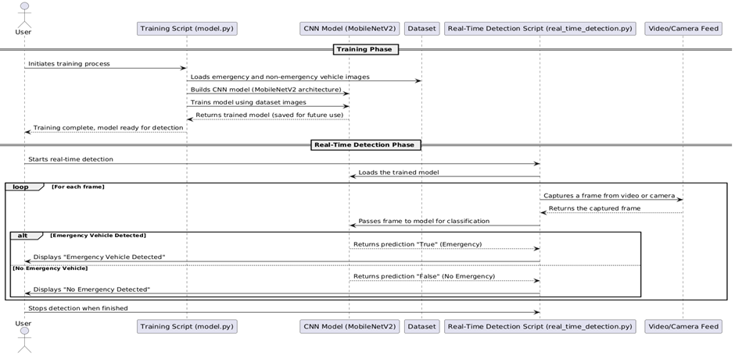
UML DIAGRAMS
SEQUENCE DIAGRAM: A sequence diagram in Unified Modeling Language (UML) is a kind of interaction diagram that shows how processes operate with one another and in what order.
Department of Artificial Intelligence & Data Science

Slide 13
SYSTEM IMPLEMENTATION
The Emergency Vehicle Detection System has key functions to detect emergency vehicles and manage traffic signals.
Real-Time Video Capture: Captures live video from cameras at intersections for monitoring.
Image Preprocessing: Enhances captured frames to optimize them for detection.
Vehicle Detection: Uses algorithms (e.g., YOLO, Faster R-CNN) to detect and identify vehicles.
Emergency Vehicle Classification: Classifies vehicles using deep learning models (e.g., MobileNetV2).
Traffic Signal Adjustment: Adjusts signals for emergency vehicles to pass without delay.
Real-Time Alerts: Sends alerts to drivers and controllers when an emergency vehicle is detected.
Operator Interface: Allows operators to control and monitor the system.
Department of Artificial Intelligence & Data Science

Slide 14
IMPLEMENTATION
CODE:
!pip install roboflow
from roboflow import Roboflow
rf = Roboflow(api_key="BQ4H4sPdMabRQX9Gzt4W")
project = rf.workspace("yolov7-v0erh").project("emergency-nonemergency-vehicle")
version = project.version(7)
dataset = version.download("coco")
# Clone YOLOv5 repository
!git clone https://github.com/ultralytics/yolov5.git
%cd yolov5
# Install dependencies
!pip install -r requirements.txt
Department of Artificial Intelligence & Data Science

Slide 15
import os
import shutil
import yaml
# Define paths for the original and processed data
images_path = "/content/emergency-nonemergency-vehicle-7/train" # Original images path
coco_annotations_path = "/content/emergency-nonemergency-vehicle-7/train/_annotations.coco.json" # Path to COCO annotations JSON file
# Define output directories for processed data
output_dir = "/content/processed_dataset"
images_output_dir = os.path.join(output_dir, "images")
labels_output_dir = os.path.join(output_dir, "labels")
# Create the directories if they don't exist
os.makedirs(images_output_dir, exist_ok=True)
os.makedirs(labels_output_dir, exist_ok=True)
Department of Artificial Intelligence & Data Science

Slide 16
# Function to convert COCO bounding box to YOLO format
def coco_to_yolo_bbox(image_width, image_height, bbox):
"""
Converts COCO bbox format [x_min, y_min, width, height] to YOLO format.
The YOLO format is [x_center, y_center, width, height], all normalized by the image size.
"""
x_min, y_min, width, height = bbox
x_center = x_min + width / 2.0
y_center = y_min + height / 2.0
return [
x_center / image_width,
y_center / image_height,
width / image_width,
height / image_height,
]
Department of Artificial Intelligence & Data Science

Slide 17
# Read COCO annotations (assuming the annotations are in a proper JSON format)
import json
with open(coco_annotations_path, 'r') as coco_file:
coco_annotations = json.load(coco_file)
# Process all images and annotations
for image_info in coco_annotations["images"]:
# Image details
image_id = image_info["id"]
file_name = image_info["file_name"]
image_width = image_info["width"]
image_height = image_info["height"]
source_image_path = os.path.join(images_path, file_name)
# Copy image to output directory
destination_image_path = os.path.join(images_output_dir, file_name)
shutil.copyfile(source_image_path, destination_image_path)
Department of Artificial Intelligence & Data Science

Slide 18
# Collect annotations for this image
image_annotations = [
ann for ann in coco_annotations["annotations"] if ann["image_id"] == image_id
]
# Create label file
label_file_path = os.path.join(labels_output_dir, file_name.replace(".jpg", ".txt"))
with open(label_file_path, "w") as label_file:
for annotation in image_annotations:
category_id = annotation["category_id"]
bbox = annotation["bbox"]
yolo_bbox = coco_to_yolo_bbox(image_width, image_height, bbox)
yolo_bbox_str = " ".join(map(str, yolo_bbox))
label_file.write(f"{category_id - 1} {yolo_bbox_str}\n")# YOLO category IDs are zero-based
Department of Artificial Intelligence & Data Science

Slide 19
# Create the data.yaml file
yaml_file_path = '/content/data.yaml'
yaml_content = """
train: /content/processed_dataset/images
val: /content/processed_dataset/images
nc: 2
names: ['emergency', 'non-emergency']
"""
# Write the YAML file
with open(yaml_file_path, 'w') as yaml_file:
yaml_file.write(yaml_content)
print("Dataset processing complete!")
print(f"Processed images saved in: {images_output_dir}")
print(f"Processed labels saved in: {labels_output_dir}")
print(f"data.yaml file created at: {yaml_file_path}")
Department of Artificial Intelligence & Data Science

Slide 20
# Train YOLOv5 on the emergency vehicle dataset
!python train.py \
--img 640 \
--batch 16 \
--epochs 10 \
--data /content/data.yaml \
--weights yolov5s.pt
from google.colab import files
# File path to download
file_path = "runs/train/exp4/weights/best.pt"
# Download the file
files.download(file_path)
Department of Artificial Intelligence & Data Science

Slide 21
# Testing the Model
# Load YOLOv5 for inference from the local repository
from pathlib import Path
import sys
sys.path.append(str(Path('/content/yolov5').resolve())) # Add YOLOv5 repo to path
import torch
from IPython.display import Image, display
# Load the model
model = torch.hub.load('ultralytics/yolov5', 'custom', path='runs/train/exp4/weights/best.pt')
# Run inference on an image
img_path = "/content/test2.jpg"
results = model(img_path)
# Display results
results.show() # Display image with predictions
results.save() # Save the result image
Department of Artificial Intelligence & Data Science

Slide 22
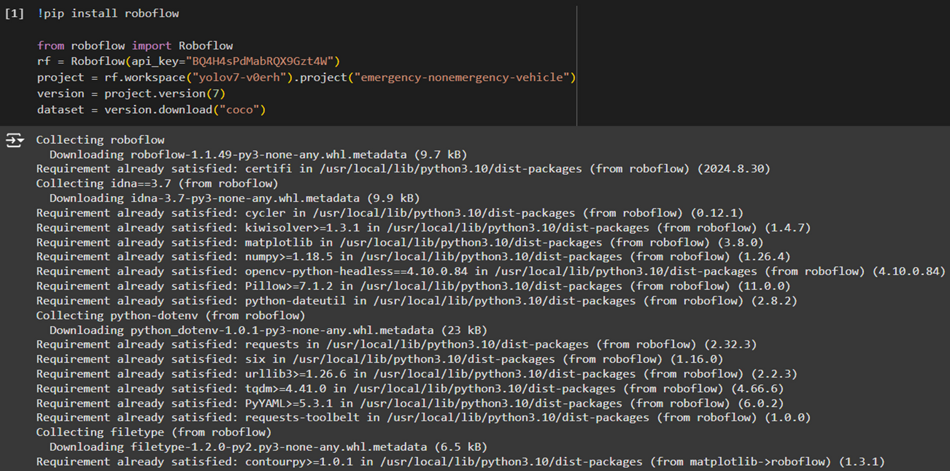
Department of Artificial Intelligence & Data Science

Slide 23
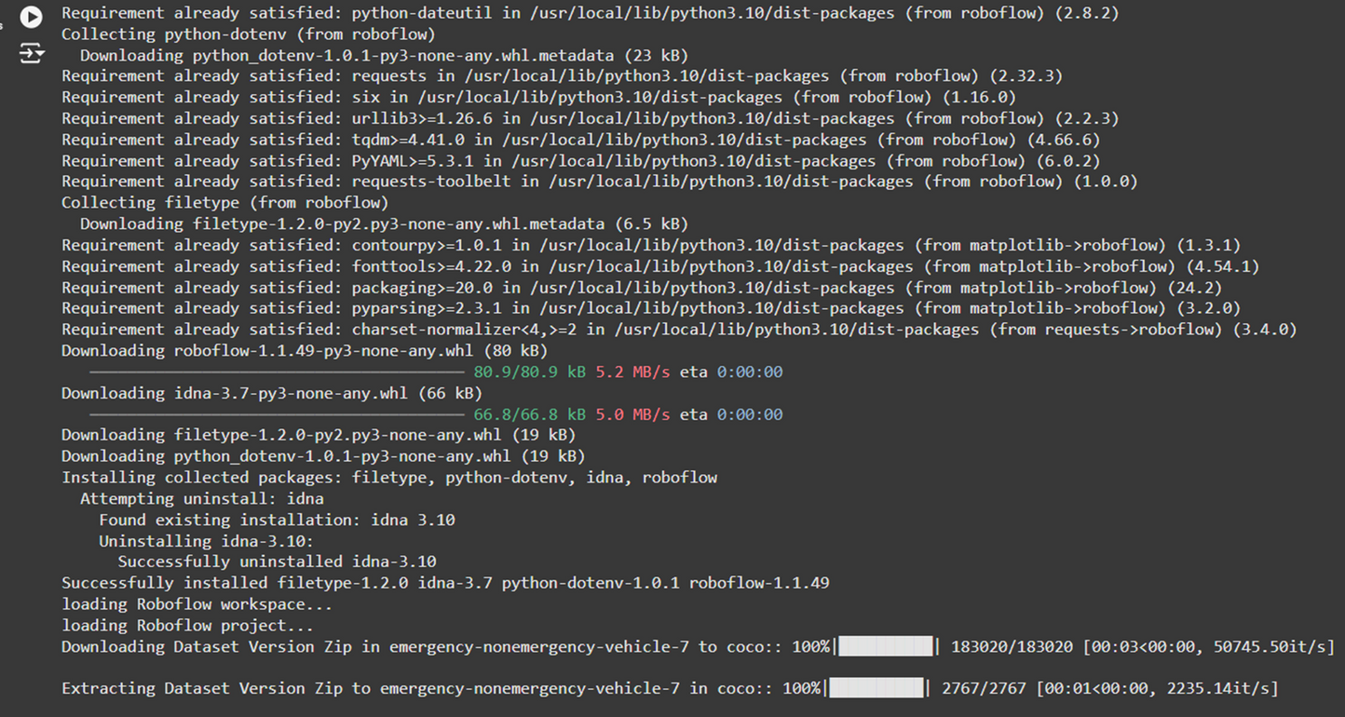
Department of Artificial Intelligence & Data Science

Slide 24
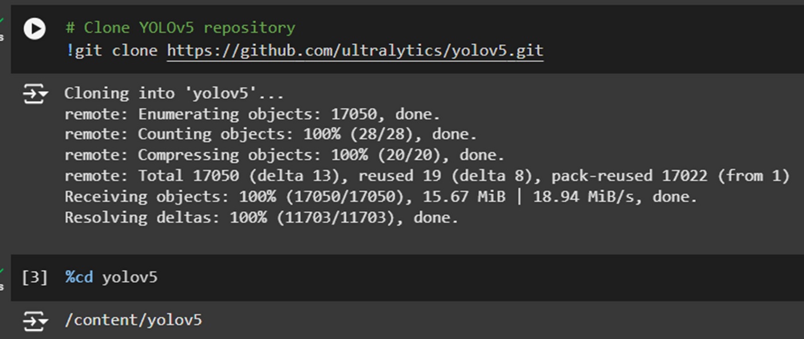
Department of Artificial Intelligence & Data Science

Slide 25
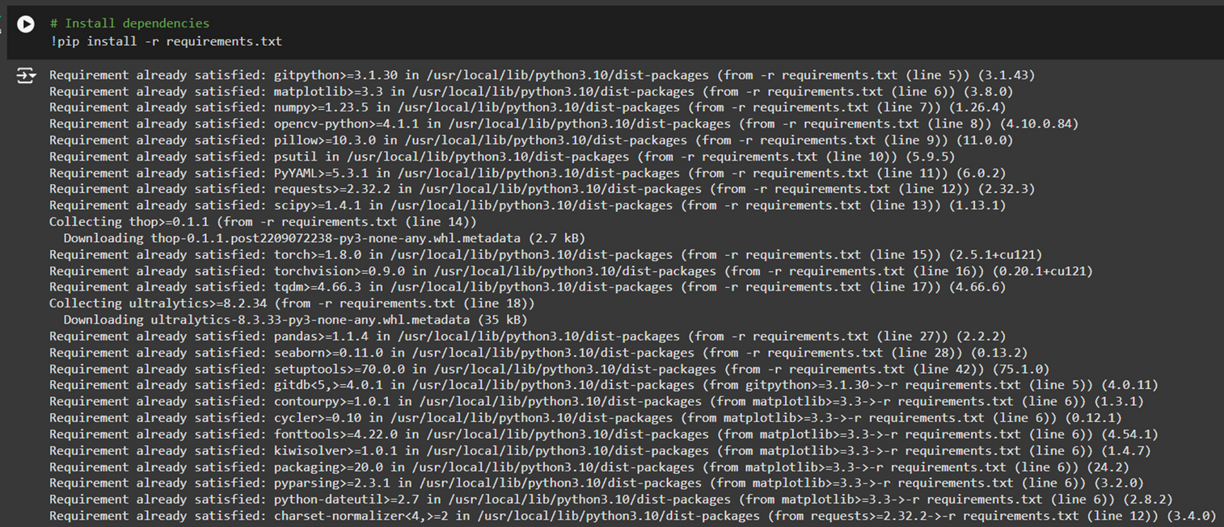
Department of Artificial Intelligence & Data Science

Slide 26
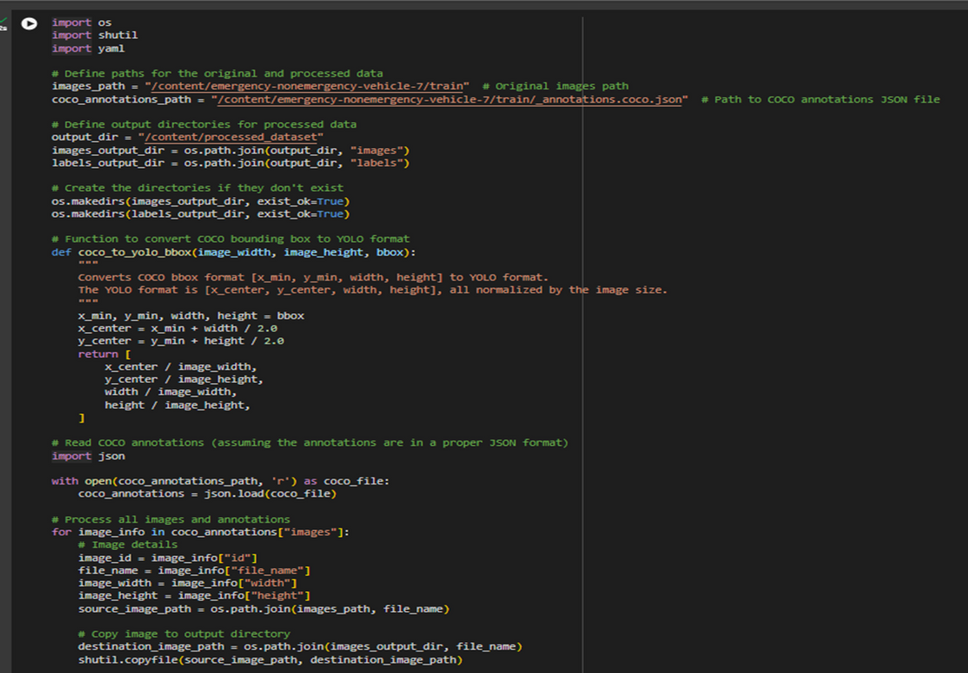
Department of Artificial Intelligence & Data Science

Slide 27
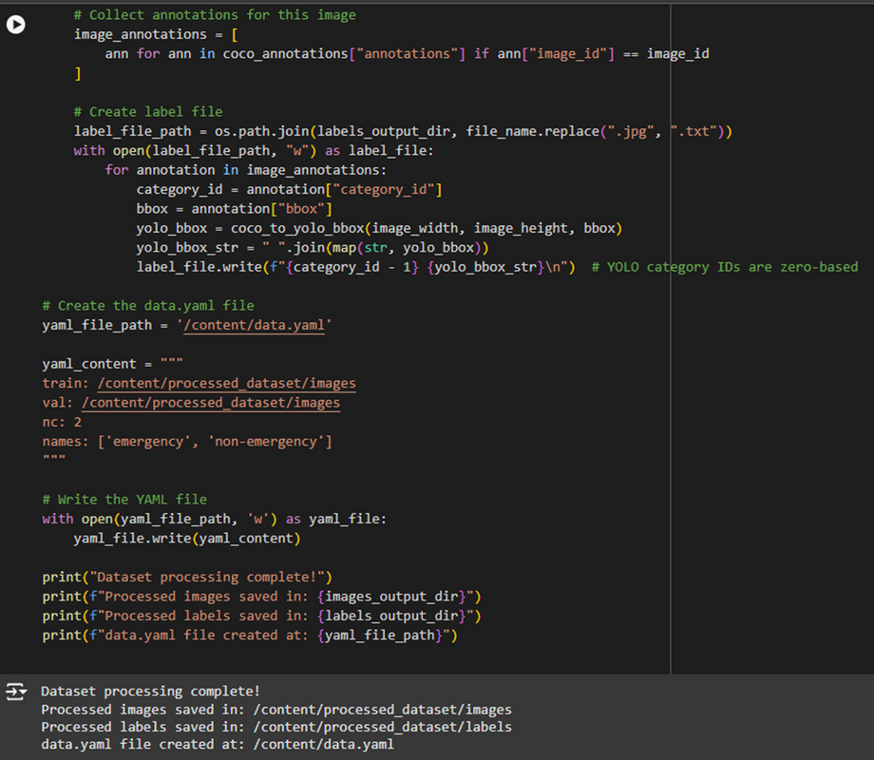
Department of Artificial Intelligence & Data Science

Slide 28
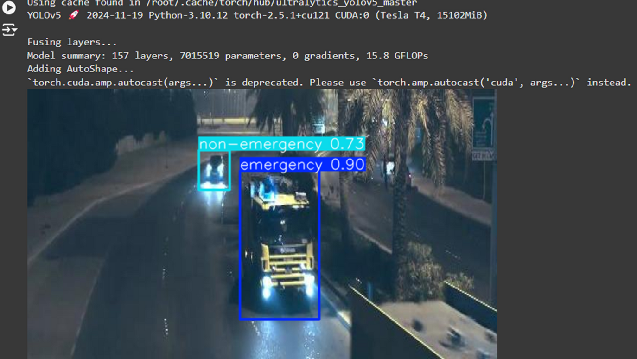
Department of Artificial Intelligence & Data Science

Slide 29
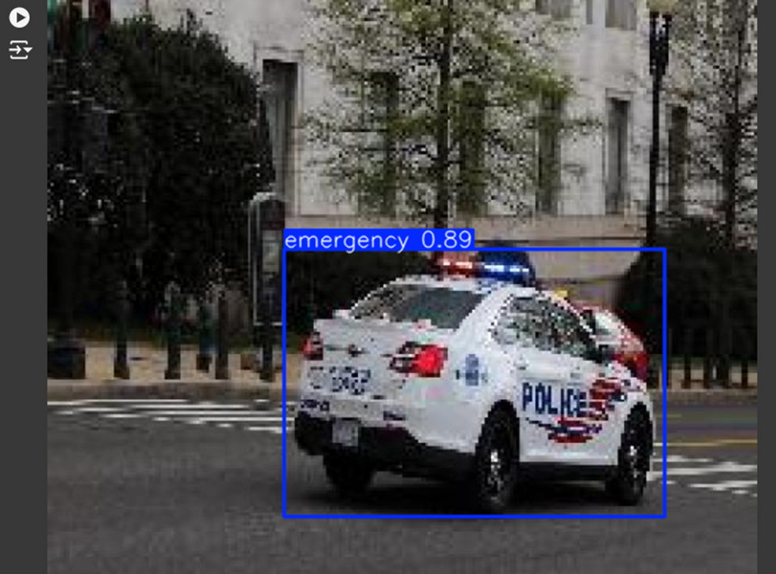
Department of Artificial Intelligence & Data Science

Slide 30
REFERENCES
[1].R.S.B.Vanjale, SayaleeDeshmukh.IOT based Traffic Signal control for reducing time delay of an Emergency Vehicle using GPS, April 6-8, 2016, India. Issue 5pag, IEEE ISBN:978-1- 5090-0396-9/16/$31.00 Â©2016 IEEE.
[2]. Dheeraj Dang, JitinTanwary and SarfarazMasoodz.A Smart Traffic Solution for High Priority Vehicles, 4-5 September 2015 ,ISBN: 978-1- 4673-6809-4/15/$31.00 Â©2015 IEEE.\
[3]. Meera K, Mpho K. Madisal. Android and Cloud based Traffic Control System, ISBN:978-1-5386-3060- 0/18/$31.00 Â©2018 IEEE. [4].Nicolas Smith,SoufieneDjahel, Shen Wang, and John Murphy. Reducing Emergency Services Response Time in Smart Cities: An Advanced Adaptive and Fuzzy Approach,ISBN:978-1-4673- 6552- 9/15/$31.00Â© 2015IEEE
[4].B.Janani Saradha,G.Vijayshri,T.Shubha.Intelligent Traffic Signal Control System For Ambulance Using RFID And CLOUDs: ISBN: 978-1-5090-6221- 8/17/$31.00Â©2017 IEEE.
[5]. https://www.mdpi.com/1424-8220/16/11/1892
[6]. https://pubmed.ncbi.nlm.nih.gov/27834924/
[7].https://www.ncbi.nlm.nih.gov/pmc/articles/PMC5134551/
Department of Artificial Intelligence & Data Science

Slide 31
CONCLUSION:
The project’s scope outlines a comprehensive approach to leveraging visual sensing technologies for prioritizing emergency vehicles in urban traffic environments. It combines the latest advancements in computer vision, machine learning, real-time traffic control, and data integration to create an intelligent and responsive traffic management system that enhances public safety and optimizes the flow of traffic.
The proposed visual sensing-based traffic management system addresses the challenges of urban traffic by dynamically prioritizing emergency vehicles. Real-time video data and advanced AI techniques detect, identify, and prioritize emergency vehicles to minimize delays and enhance response times. Object detection algorithms such as YOLO and Faster R-CNN enable vehicle detection, and CNNs classify emergency vehicle types with high accuracy. Video preprocessing techniques such as noise reduction and background subtraction enhance reliability. Real-time detection is integrated with adaptive signal control and rerouting to optimize traffic flow. This scalable, AI-driven solution improves the efficiency of emergency response and integrates well with existing road infrastructure for safer, smarter roads.
In conclusion, we conclude this visual sensing-based system is capable of efﬁciently adaptive and data-driven emergency vehicle prioritization systems that revolutionize urban traffic management.
Department of Artificial Intelligence & Data Science

Slide 32
THANK YOU
Department of Artificial Intelligence & Data Science

